Slide 1
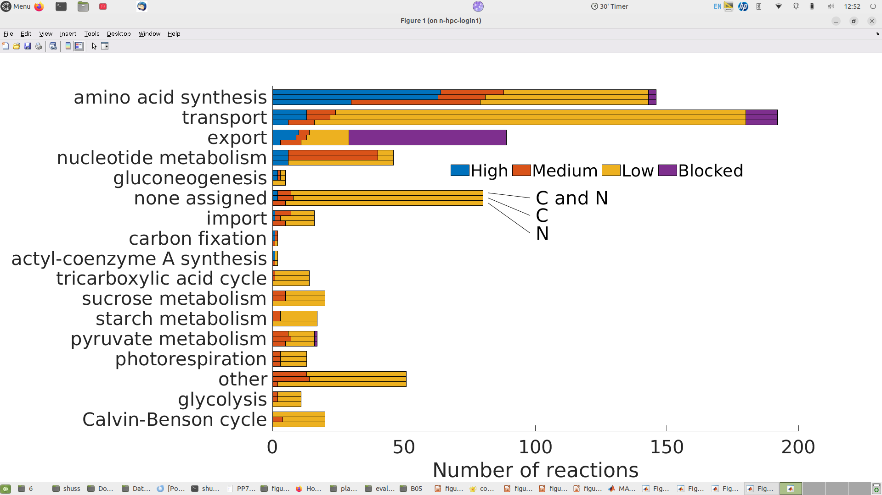
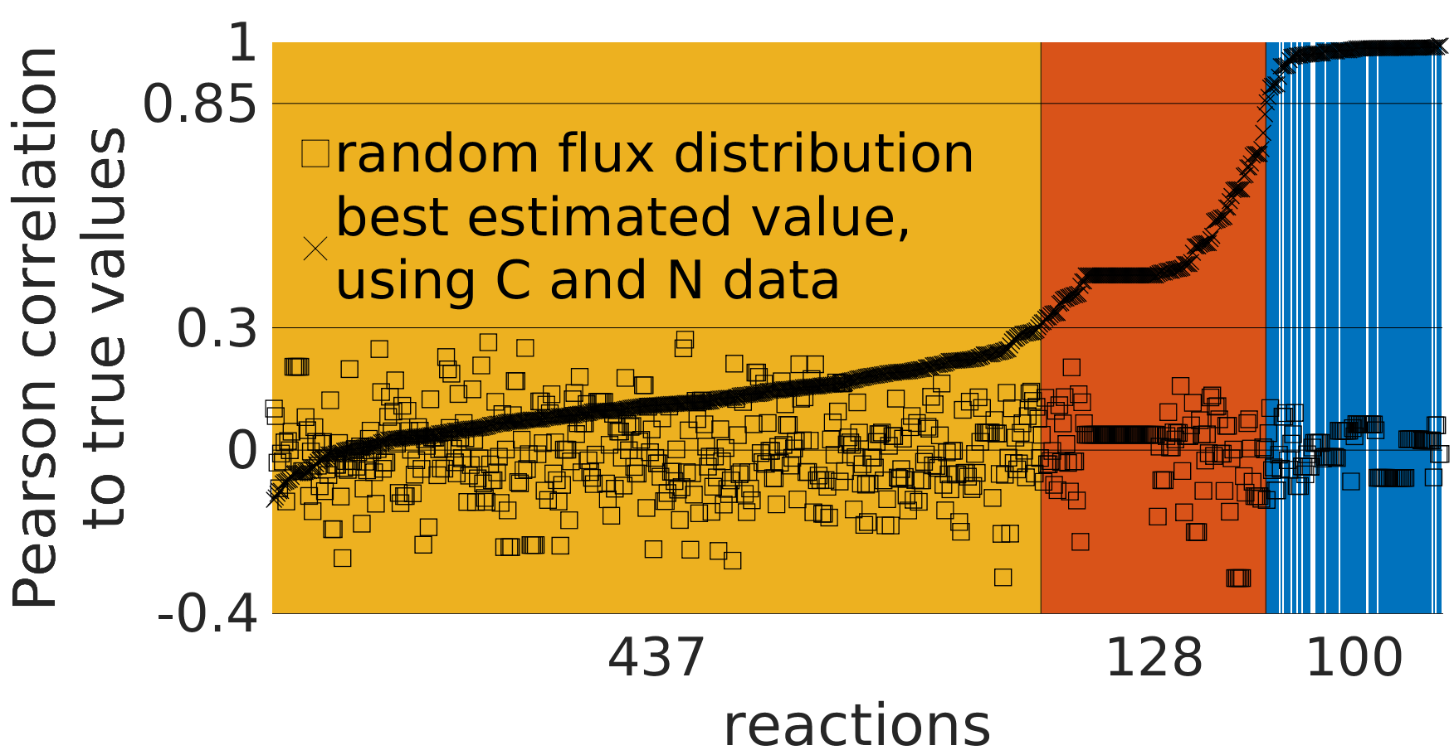

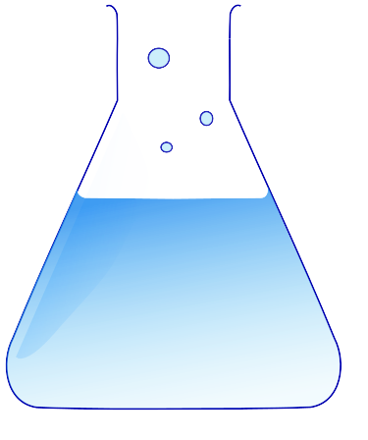
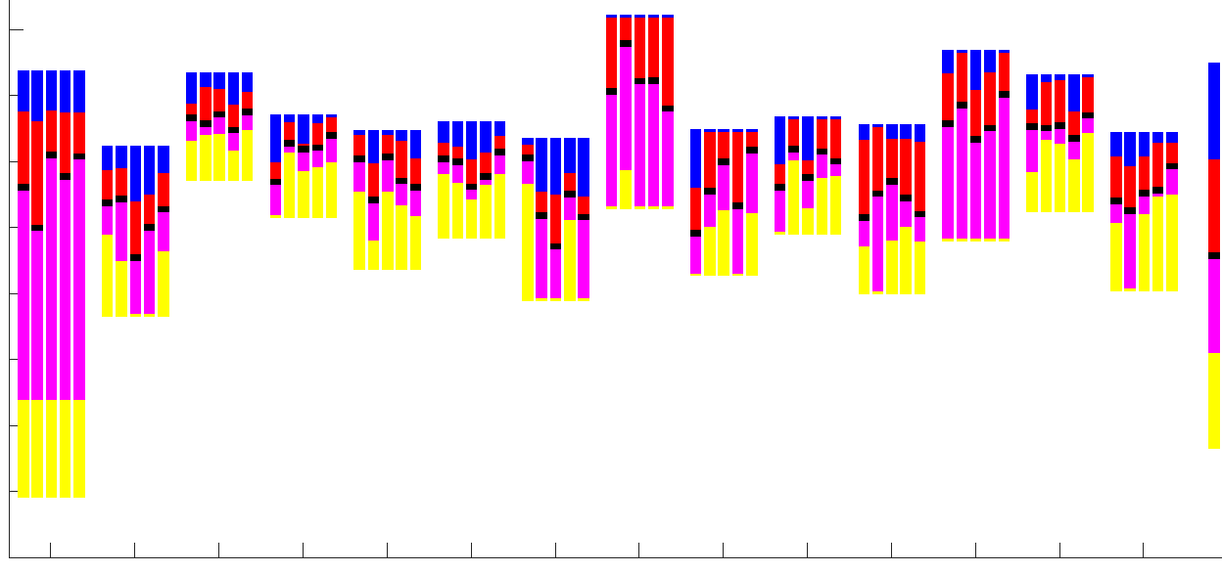
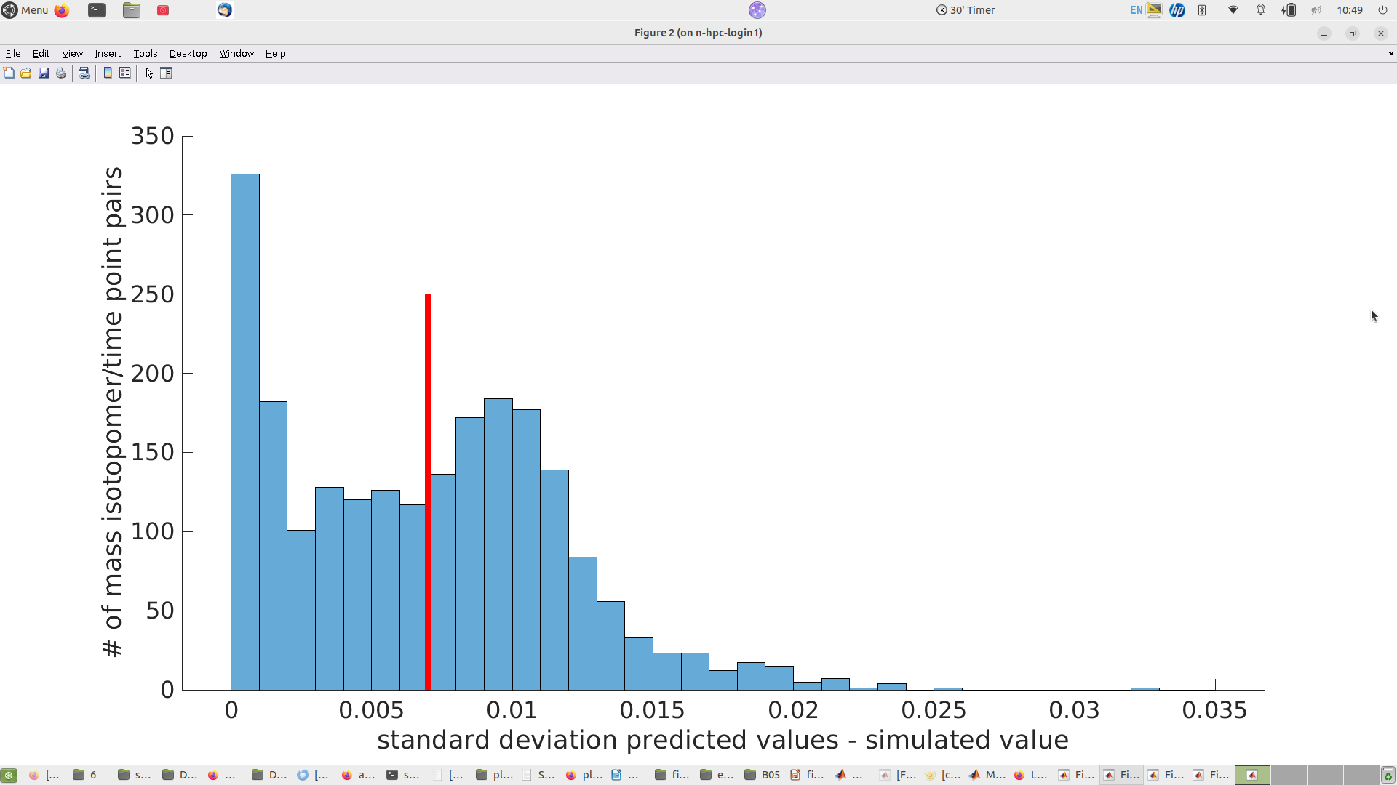
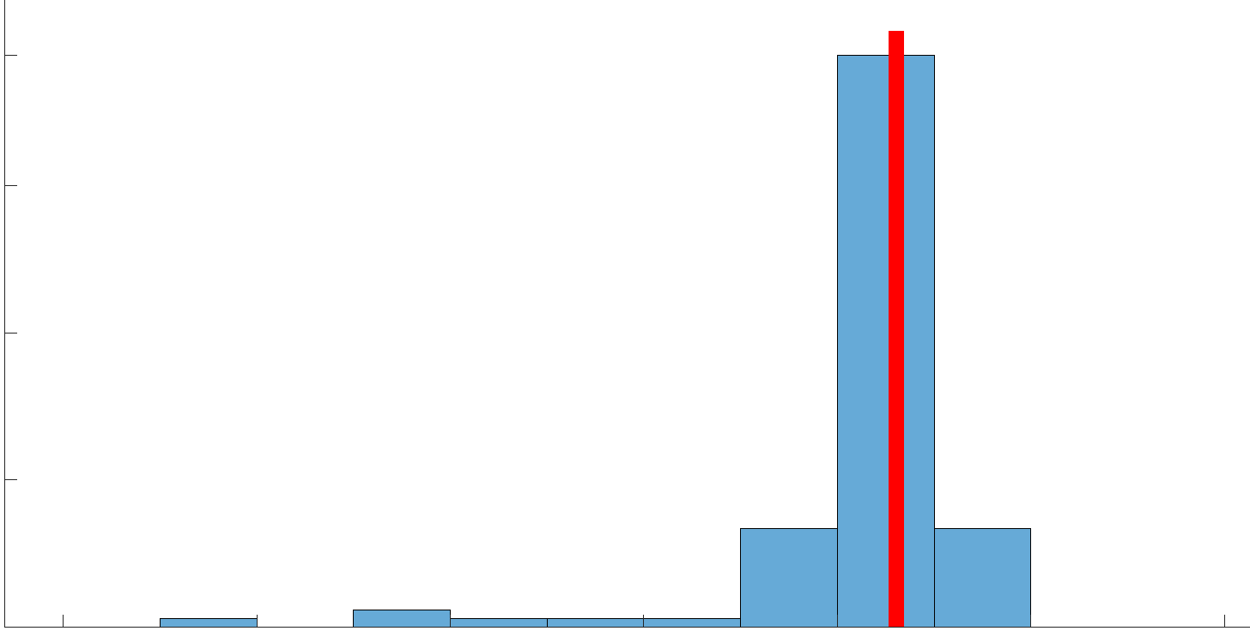
a
b
c
vN,cN
A
B
C
...
g
1
2
1
2
1
2
N
Reaction fluxes v
$\frac{dx}{dt}=f\left(v,c,x\right)$
v1,c1
v1
v2
sample
D
simulate
MID fraction x
v3
1
2
3
4
Metabolite concentrations c
time
d
e
h
MID fraction x
time
f
k
2
v
1
max flux
0
upper limit
99% CI
Flux value
L
-1
c
log-transformed flux
true value
reaction
-2
reactions
lower limit
99% CI
-3
-4
min flux
$L=\sum{{\left(\frac{{MID}_{meas}−{MID}_{pred}}{σ_{MSD}}\right)}^{2}}$
-5
i
300
j
70
Urease [h]
Aspartic acid kinase [h]
Threonine synthase [h]
Tryptophan synthase [h]
Glutamine synthetase [c]
Chorismate synthase [h]
Acetolactate synthase 3 [h]
# of mass flux distribution samples
Acetolactate synthase 1 [h]
Dihydroxy-acid dehydratase [h]
Arogenate dehydrogenase [h]
# of mass isotopomer / time point pairs
Dihydrodipicolinate synthase [h]
Formate–tetrahydrofolate ligase [h]
O-Phosphoserine aminotransferase [h]
150
Methylenetetrahydrofolate reductase [c]
0
0
0
0.01
0.02
0.03
400
500
600
standard deviation
predicted values - simulated value
computation time ratio
simulation / surrogate neural network

